Slide 1

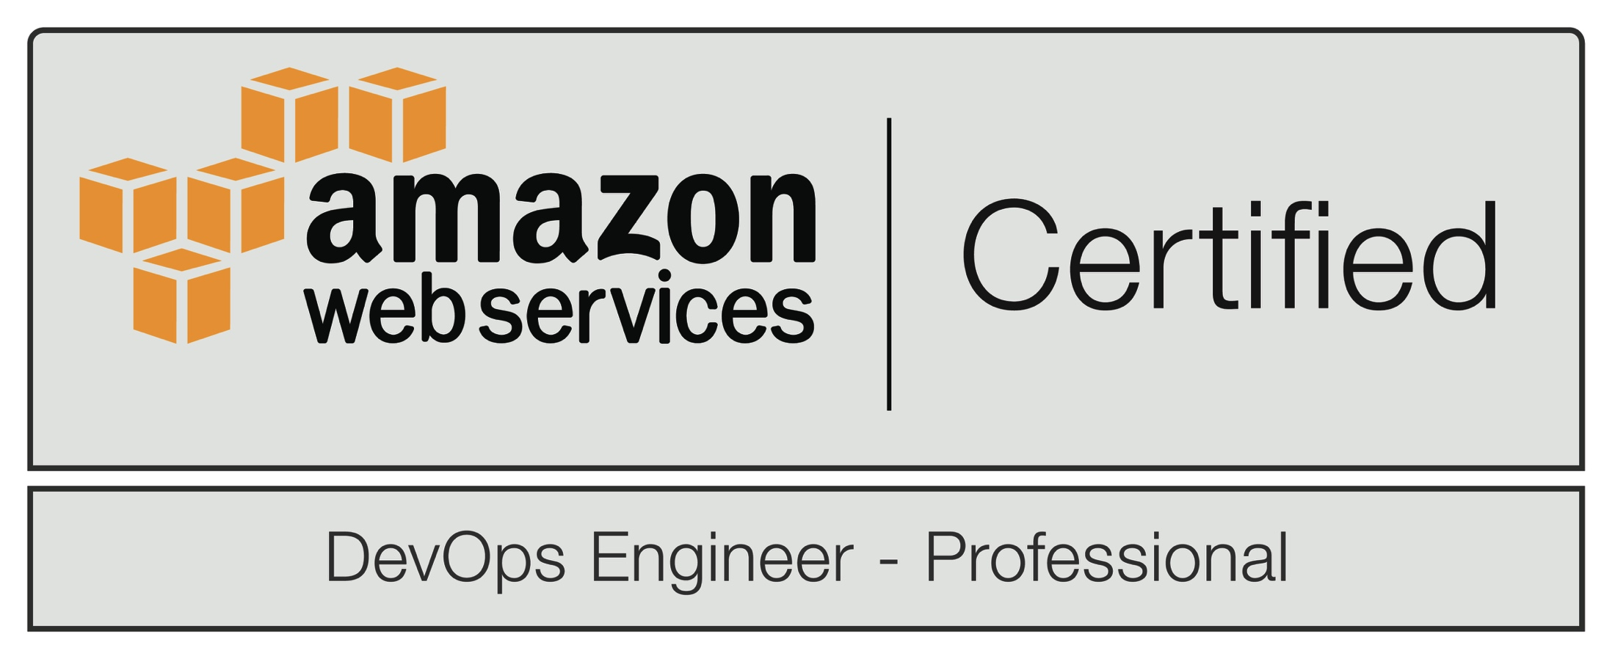

CAS Snapshot
WHO WE ARE
Cloud Admin Services is an IT consulting group that specializes in software deployment and cloud management. Our experts improve application deployment into the Amazon Web Services cloud through automation which lowers risk and adds value.
WHAT WE DO
We deploy infrastructure (servers, storage, networking) into Amazon Web Services, then create the systems and processes to deploy applications onto that infrastructure (databases, web & packaged applications) in an automated way that allows more frequent deployments with less risk because it can be fully verified at any time and security and compliance are maintained as a native part of the solution.
OUR MISSION
To provide exceptional value and savings to our customers by delivering superior cloud management and software deployment expertise that advances systems by unleashing the power of automation.
OUR GUIDING PRINCIPLES
Cloud Management & Migration
Software Deployment Systems
DevOps Expertise
HOW CAN WE HELP YOU?
What are your cloud management challenges?
What are your software deployment challenges?

